Slide 2
Timeline of CM Budget News Before COVID-19
January 21, 2020: Governor Cuomo proposed a 28.5 billion spending plan for education (CM was going to get 2.94% increase)
Preliminary Public Session BOE Budget Conversations
Adding All Day Pre-K
Adding Agriculture program
March 14th Superintendent Letter Closing Schools
Online Learning and distribution of paper/pencil activities
March 31st Superintendent Letter Canceling April Break

Slide 3
Timeline of CM Budget Continued…
April 3, 2020: NYS Agrees to the 2020-21 Budget
Announces all schools in 2020-21 will get the same state aid as 2019-20 school year
The devil is in the details
CM amount for the Federal Cares Restoration is $184,895.
Quarterly Take Backs!

Slide 4
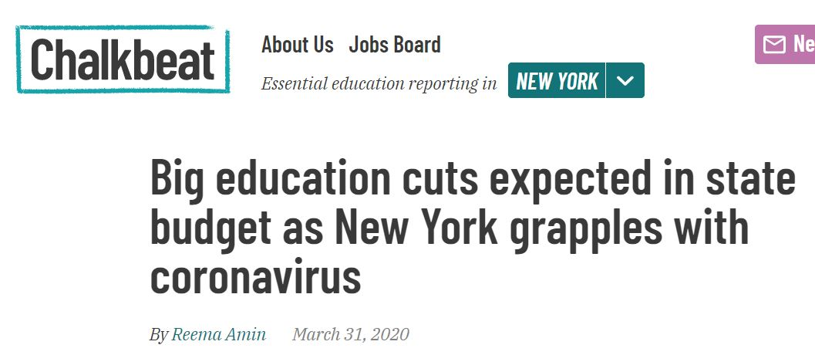
News Headlines

Slide 5
History Tells Us
2008 Stock Market Crash
During that financial crisis from 2010-2015 our school budget was reduced by a total of 6.4 million dollars
The worst yearly cut was 2011-12 school year with a 1.8-million-dollar reduction

Slide 6
Planning for the Future
Maintain Programs
Made structural changes, not just a one moment in time cuts
Make budget adjustments that will benefit the district financially year after year
Make cuts through attrition when possible

Slide 7
Personnel Changes
Reconfiguration saved 4-5 teacher level positions
Offered Retirement Incentive
Resulted in Four Teacher Retirements
Saved current teaching positions
Allowed us to add all-day Pre-Kindergarten
Allowed us to add Agriculture Program

Slide 8
Benefits of Reconfiguration
Consolidation of Services
7-12 Teacher Certifications all Together
Eliminates “traveling periods”
Equals 2.5 teachers
Consolidates Office Staff
Consolidates Administrative Staff
Consolidates Teacher Assignments
Consolidates Student Services
Allows for staff reductions through attrition over the years

Slide 9
Results of Staff Reductions
Reduction of Administrator
Result in layoff
Reduction in Office Staff
Reduction of two 7-12 English Teachers
Reduction through attrition, one layoff
Reduction of Technology Teacher
All Courses are intact, result in layoff
Reduction of .5 FACS Teacher
All Courses intact, result in layoff

Slide 10
2021 Budget Benefits
Budget to Budget decrease of $948,789.00
Budget amount equals an anticipated 10% less in State Aid
Class Sizes are still relatively small
No Cuts to Educational Programs
Program Enhancements
All Day Pre-K
Agriculture Program
Implementation of New Reading Program
Budget is well under the Tax Cap

Slide 11
Budget Development
2019-2020 Approved Budget: $21,842,479
2020-2021 Proposed Budget: $20,893,690

Slide 12
2020-2021 ANTICIPATED EXPENDITURE BUDGET
Description | 2019-2020 | 2020-2021 | $ Change | % Change
ADM | $1,996,539 | $2,002,211 | 5,672 | .28%
PROGRAM | $15,283,409 | $14,169,368 | (1,114,041) | (7.29%)
CAPITAL | $4,562,531 | $4,722,111 | 159,580 | 3.50%
Total Budget | $21,842,479 | $20,893,690 | (948,789) | (4.34%)

Slide 13
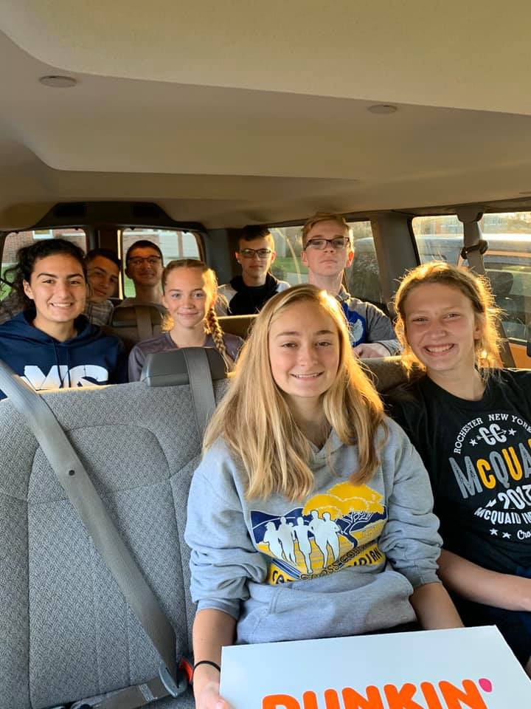
REAL PROPERTY TAX CAP
2019-2020
CPI: 2.44%
Cato-Meridian School District must stay within tax levy cap of 4.29%
2020-2021
CPI: 1.81%
Cato-Meridian School District must stay within tax levy cap of 4.70%

Slide 14
2020-2021 State Aid
$ 207,278 year to year State Aid Increase
($ 184,895) potential pandemic adjustment
District preparing for 10% reduction in Foundation Aid

Slide 15
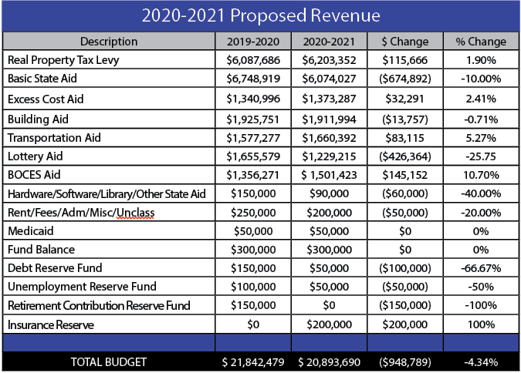
Revenue 2020-2021

Slide 16
Vehicle Proposition: $355,000
Current transportation aid ratio – 90%
Two 65 Passenger Buses
One Small Handicapped Accessible Bus
One Stake Rack Truck

Slide 17
Property Tax Report Card Comparison
 | 2017-2018 | 2018-2019 | 2019-2020 2020-2021
Total Proposed Spending | $20,817,405 | $21,360,267 | $21,842,479 $20,893,690
Total Proposed Tax Levy | $5,809,854 | $5,939,206 | $6,087,686 $6,203,352
Permissible Exclusions | $259,696 | $244,266 | $348,199 $496,606
School Tax Levy Limit Less Exclusions | $5,571,924 | $5,694,940 | $5,845,793 $5,802,201
Proposed Levy Less Exclusions | $5,500,158 | $5,644,940 | $5,664,487 $5,631,746
Difference (negative requires 60% vote) | $ 71,766 | $ 50,000 | $ 181,306 $ 170,455

Slide 18
HISTORICAL TAX LEVY
YEAR | 2012-13 | 2013-14 | 2014-15 | 2015-16 | 2016-17 | 2017-18 | 2018-19 | 2019-20 | 2020-21*
TAX LEVY | 1.90% | 1.90% | 1.40% | 1.56% | .37% | .37% | 2.23% | 2.50% | 1.90%*
TRUE TAX PER $1000 | $17.97 | $18.32 | $18.32 | $18.44 | $18.19 | $18.14 | $18.25 | $18.06 | $18.42*
 |  |  |  |  |  |  |  | *ESTIMATE

Slide 19
2020-2021 Budget Recap
Proposition #1: 2020-2021 Proposed Budget of $20,893,690
Pre-K will transition to all day
addition of an Agriculture Program
a new reading program will be implemented
a Discharge Modification Septic Outflow project will be addressed

Slide 20
2020-2021 Budget Recap
Proposition #2:
District will be purchasing the following vehicles:
- Two 65 passenger buses
- One small handicapped accessible bus
- One stake rack pick-up truck

Slide 21
Annual Budget Vote
June 9, 2020
All voting will be done via absentee ballot
Each household will receive at least one absentee ballot
Additional absentee ballots can be obtained from the District Clerk
All absentee ballots are due in the District office no later than 5:00 pm on Tuesday, June 9, 2020 via the United States Postal Service
PLEASE VOTE!!

